Slide 1
Policy and Planning Division
Community Indicators
May 5, 2016

Slide 2




Ramsey County Vision, Mission and Goals
Vision: A vibrant community where all are valued and thrive.
Mission: A county of excellence working with you to enhance our quality of life.
Goals
Strengthen individual, family and community health, safety and wellbeing through effective safety-net services, innovative programming, prevention and early intervention, and environmental stewardship. | Cultivate economic prosperity and invest in neighborhoods with concentrated financial poverty through proactive leadership and inclusive initiatives that engage all communities in decisions about our future. | Enhance access to opportunity and mobility for all residents and businesses through connections to education, employment and economic development throughout our region | Model fiscal accountability, transparency and strategic investments through professional operations and financial management.

Slide 3
Community Indicators
Indicator selection criteria
Does the indicator come from existing, reputable data?
The credibility of the indicators is paramount. By focusing on well-established, widely-accepted measures, the Community Indicators seek to provide positive analysis rooted in transparent sources.
Can the indicator be readily compared with the region as a whole?
Since data vary by the geographies in which they are collected, calculated and reported, using indicators for which information was available both for Ramsey County alone and with which appropriate aggregation encompassing the entire 7-County Region was possible remained an important threshold by which selection of the Community Indicators were considered.
Does the indicator have (or with reasonable certainty will it soon have) trend data?
Understanding the baselines by which to evaluate progress was an important criteria for selecting the Indicators. A critical objective of the County’s Managing for Results program is the ability to assess incremental progress toward the County’s vision, mission and goals.
Does the indicator speak to progress toward our vision, mission and goals?
Finally, aligning Community Indicators with Ramsey County’s vision, mission and goals creates an opportunity for open, policy-driven dialogue centered on residents and community.

Slide 5
The following four indicators were selected because they illustrate issues central to individual, family and community safety, health and well-being. This year Low Birthweight births are highlighted to emphasize our focus on residents aged 0 to 24 in Ramsey County’s Family and Youth Continuum of Care.
 | Part I Crimes (per 100,000) | Low Birthweight | Recycling rate | Adults report inadequate social-emotional support
Ramsey County
7-County Metro
3,738
7.3%
52.5%
14.3%
2,972
6.5%
47.7%
13.1%

Slide 7
These four indicators were selected because they speak directly to the lived experiences of our residents from a macroeconomic perspective. This year we highlight the gap between median household income and median cost of living because of the need to focus on access to jobs, mixed income community development and the attracting of living wage employment.
 | Employment Growth from previous year | Percent between Median Household Income and Median Cost of Living | Percent of Full-Time Workers living Below Poverty Level | Percent of residents living in areas of concentrated financial poverty
Ramsey County
7-County Metro
1.0%
-3%
2.5%
29.9%
1.5%
18%
1.4%
13.8%

Slide 9
These four indicators were selected because Ramsey County is a community that it is poised for growth. This year we highlight commute times because driving investments in transit and economic development benefits residents today and positions the community for future growth.
 | Percent of population 25 to 34 years old | Percent of commuters who can commute to work in less than 30 minutes | Percent of Highway miles rated in “poor” condition | Poverty rate for People of Color
Ramsey County
7-County Metro
16%
70%
8.8%
31.6%
15%
66%
4.3%
25.3%

Slide 11

These eight indicators were selected because they illustrate the degree of mutual engagement between Ramsey County residents and their County government. This year we highlight voter turnout as a percentage of eligible voters because it demonstrates residents engaged with their community and their government.
 | Voter turnout as a percentage of eligible voters | Moody’s Aaa Standard & Poor’s AAA Bond Ratings | Assessment Ratio | Net Bonded Debt Per Capita
Ramsey County
7-County Metro
69.8%
$$√$$
96.5
$357
75.3%
3
95.8
$394

Slide 12
Here we’ve highlighted the Net Bonded Debt Per Capita for Ramsey County, each of the other six counties in the 7-County Region and the Metropolitan Council. This indicator emphasizes the net value of government borrowing on behalf of residents across the Region. It demonstrates Ramsey County’s commitment to ensuring its residents aren’t further burdened by property taxes.
Net Bonded Debt Per Capita: | Anoka County | Carver County | Dakota County | Hennepin County
 | Ramsey County | Scott County | Washington County | Metropolitan Council
$437
$215
$80
$683
In the recent past Dakota County has been able to finance much of its capital improvement through earned investment income. Therefore Dakota County has very little outstanding debt.
$357
$502
$489
$303

Slide 13
Questions ?
Comments ?
THANK YOU

Slide 14
Source: MN Compass

Slide 16
n = 14,882 n = 2,945

Slide 17
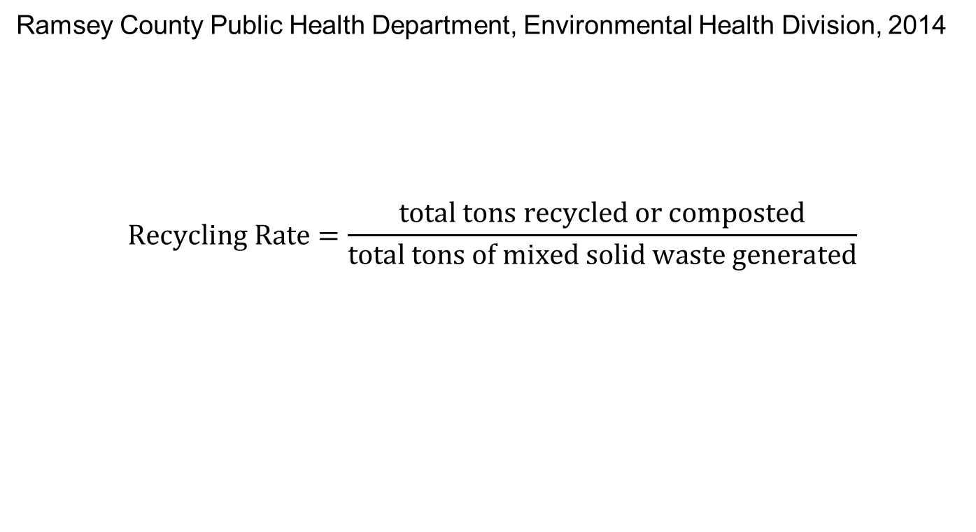
Ramsey County Public Health Department, Environmental Health Division, 2014
$$Recycling Rate=\frac{total tons recycled or composted}{total tons of mixed solid waste generated}$$

Slide 18
U.S. Census Bureau American Community Survey 5-yr estimates, 2014
Minnesota Department of Employment and Economic Development, 2015

Slide 19
U.S. Bureau of Labor Statistics Quarterly Census of Employment and Wages

Slide 20
U.S. Census Bureau American Community Survey 5-yr estimates, 2009-2014

Slide 21
-8%
-5%

Slide 22
Areas of concentrated financial poverty are defined as census tracts where more than 20 percent of resident households have income below the federal poverty level. The federal poverty level for a family of four is currently $23,850 a year.
Areas of extreme concentrated financial poverty are census tracts where 40 percent or more of resident households live below the federal poverty level.
Since 2011, Ramsey County has made significant progress in reducing contiguous areas of concentrated poverty relative to the broader 7-County region. Ramsey County’s decrease in the number of its residents living in areas of concentrated poverty has largely driven the reduction occurring in the region as a whole.
2014
2011

Slide 23
U.S. Census Bureau American Community Survey 5-yr estimates, 2009-2014

Slide 25
U.S. Census Bureau American Community Survey 5-yr estimates, 2009-2014

Slide 26
22.8%
19.7%
U.S. Census Bureau American Community Survey 5-yr estimates, 2009-2014

Slide 29
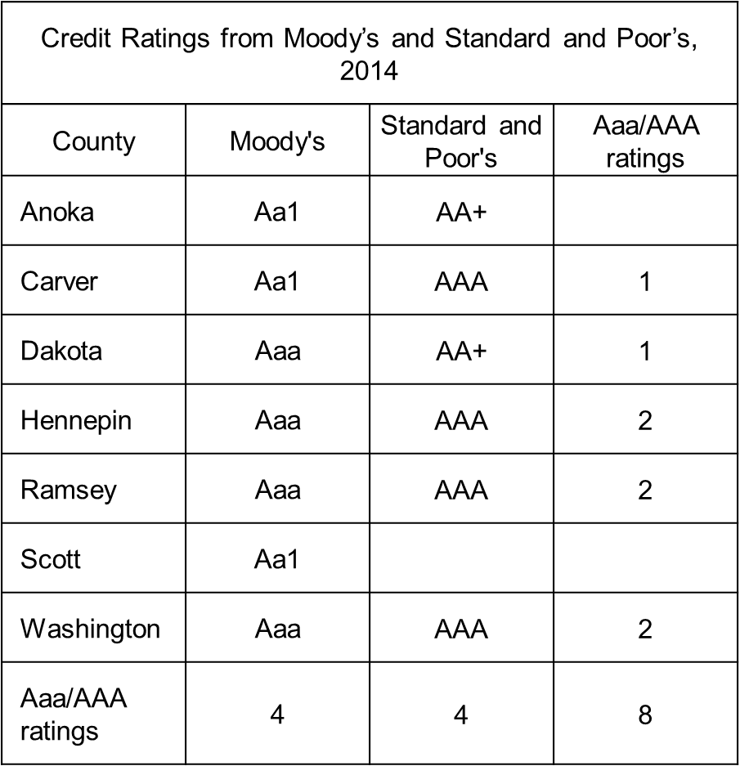

Slide 30
Global Long-Term Rating Scale
Aaa Obligations rated Aaa are judged to be of the highest quality, subject to the lowest level of credit risk.
Aa Obligations rated Aa are judged to be of high quality and are subject to very low credit risk.
A Obligations rated A are judged to be upper-medium grade and are subject to low credit risk.
Baa Obligations rated Baa are judged to be medium-grade and subject to moderate credit risk and as such may possess certain speculative characteristics.
Ba Obligations rated Ba are judged to be speculative and are subject to substantial credit risk.
Caa Obligations rated Caa are judged to be speculative of poor standing and are subject to very high credit risk.
Ca Obligations rated Ca are highly speculative and are likely in, or very near, default, with some prospect of recovery of principal and interest.
C Obligations rated C are the lowest rated and are typically in default, with little prospect for recovery of principal or interest.
Note: Moody’s appends numerical modifiers 1, 2, and 3 to each generic rating classification from Aa through Caa. The modifier 1 indicates that the obligation ranks in the higher end of its generic rating category; the modifier 2 indicates a mid-range ranking; and the modifier 3 indicates a ranking in the lower end of that generic rating category. Additionally, a “(hyb)” indicator is appended to all ratings of hybrid securities issued by banks, insurers, finance companies, and securities firms.* Note: For more information on long-term ratings assigned to obligations in default, please see the definition “Long-Term Credit Ratings for Defaulted or Impaired Securities” in the Other Definitions section of this publication. * By their terms, hybrid securities allow for the omission of scheduled dividends, interest, or principal payments, which can potentially result in impairment if such an omission occurs. Hybrid securities may also be subject to contractually allowable write-downs of principal that could result in impairment. Together with the hybrid indicator, the long-term obligation rating assigned to a hybrid security is an expression of the relative credit risk associated with that security.

Slide 31
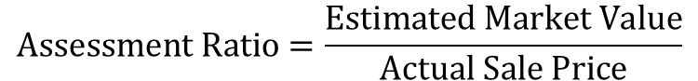
|||||||| | | | || | | ||| | | || | || | ||
$$\text{Assessment} \text{Ratio}=\frac{\text{Estimated} \text{Market} \text{Value}}{\text{Actual} \text{Sale} \text{Price}}$$
Assessment ratios indicate the accuracy of property valuation.
The ratios used here are for Residential property and are reported in the aggregate.

